Slide 1
Financial Management
Dr. Sarveshwar Kumar Inani
sarveshwarinani@wilp.bits-pilani.ac.in

Slide 2
Term Structure of Interest Rates

Slide 3
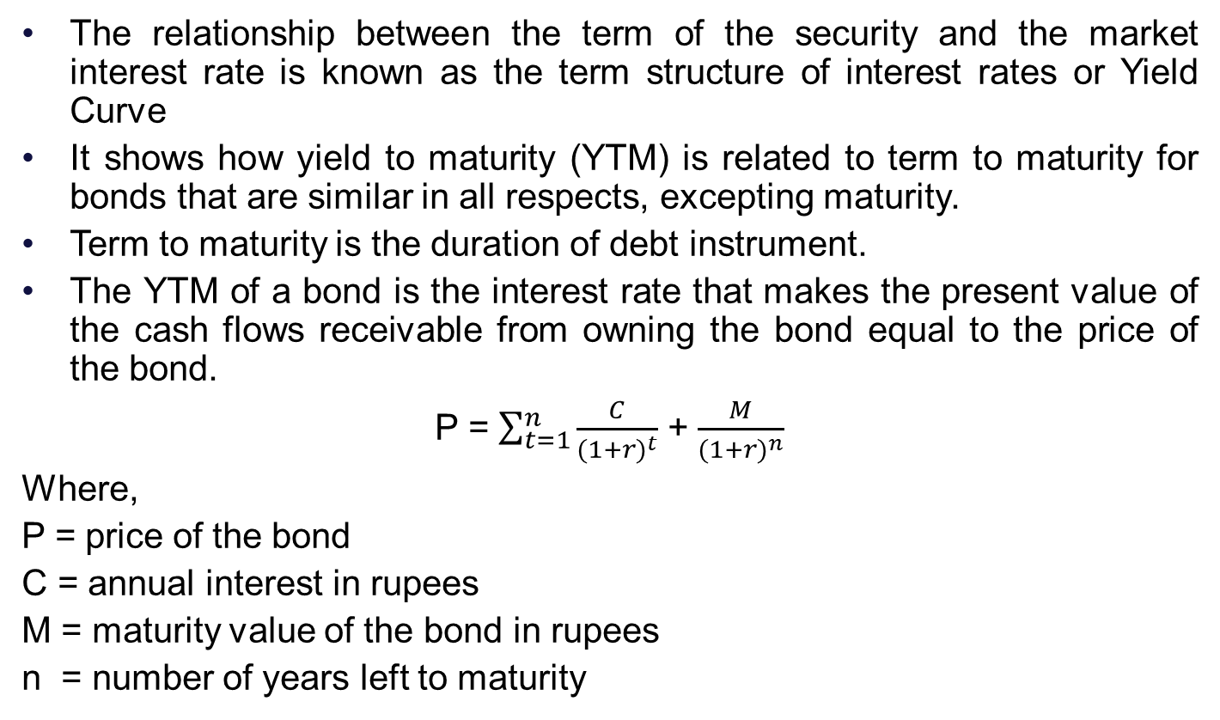
Term Structure of Interest Rates
The relationship between the term of the security and the market interest rate is known as the term structure of interest rates or Yield Curve
It shows how yield to maturity (YTM) is related to term to maturity for bonds that are similar in all respects, excepting maturity.
Term to maturity is the duration of debt instrument.
The YTM of a bond is the interest rate that makes the present value of the cash flows receivable from owning the bond equal to the price of the bond.
P = $\sum_{t=1}^{n}{\frac{C}{{(1+r)}^{t}}}$ + $\frac{M}{{(1+r)}^{n}}$
Where,
P = price of the bond
C = annual interest in rupees
M = maturity value of the bond in rupees
n = number of years left to maturity

Slide 4
Yield Curve
Consider the following data of the government securities
Face Value | Interest Rate | Current Price | Maturity (yrs) | YTM
100000 | 0 | 88968 | 1 | 12.4
100000 | 12.75 | 99367 | 2 | 13.13
100000 | 13.5 | 100352 | 3 | 13.35
100000 | 13.5 | 99706 | 4 | 13.6
100000 | 13.75 | 99484 | 5 | 13.9

Slide 5
Types of Yield Curves and its Implications
Normal
long term yields are higher than short term yields
signals that the economy is in an expansionary mode
interest rates on medium-term fixed income securities are higher than the rates of both long and short-term instruments
Humped
Flat
very little variation between short and long term yields
Inverted
short term yields are higher than long term yields
Signals that the market is unsure about the future direction of the economy
signals that the economy is in contraction mode

Slide 6
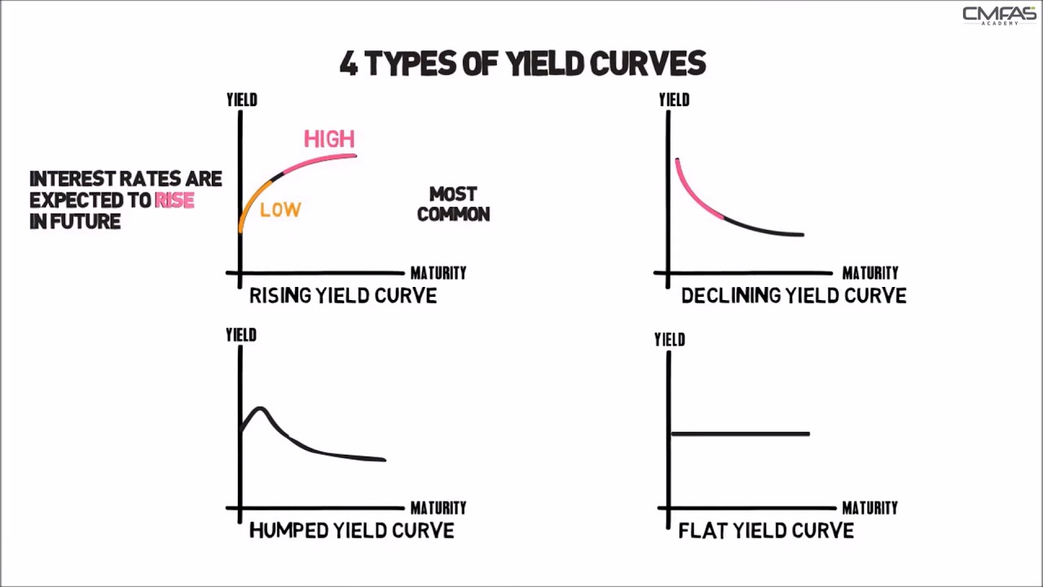
Types of Yield Curve

Slide 7
Theories of Term Structure of Interest Rates
Pure Expectations Theory:
Assumes that investors know with certainty what lies ahead of them.
Any long-term rate is equal to the geometric mean of current and future one-year rates expected by the market participants.
The shape of the yield curve can be explained by the interest rate expectations of those who participate in the market.
If the yield curve is upward sloping, short-term rates are expected to rise.
If the curve is downward sloping, short-term rates are expected to fall.
A flat yield curve implies that the market expects short-term rates to remain constant

Slide 8
Theories of Term Structure of Interest Rates
2. Liquidity Preference Theory:
Assumes that risk premium must necessarily rise with maturity because investors wish to liquidate their investments at the earliest and borrowers want to borrow long.
There is uncertainty about the one-year period return from a bond whose maturity is greater than one period. Uncertainty regarding the one-period return increases with the maturity of the bond.
Since investors are risk-averse, they require an inducement to hold long-term bonds. They will ask for a long-term rate which is higher than the average of expected future rates.
That means, forward rates should incorporate interest rate expectations + risk premium
The yield curve will have a definite upward bias because investors show a preference for short-term securities.

Slide 9
Theories of Term Structure of Interest Rates
3. Market Segmentation Theory:
An extreme format of the preferred habitat theory.
It states that investors as well as borrowers are unwilling to shift from their preferred maturity range.
Hence, the shape of the yield curve is determined entirely by the supply and demand forces within each maturity range.
The yield curve can be just about any shape, depending on the supply and demand conditions.

Slide 10
2.3 Classification of Risk

Slide 11
Classification of Risk
Business Risk Vs. Financial Risk
Market Risk, Credit Risk and Operational Risk
References
https://www.investopedia.com/terms/r/risk.asp
https://corporatefinanceinstitute.com/resources/knowledge/finance/risk/
https://www.simplilearn.com/financial-risk-and-types-rar131-article

Slide 12
Business Risk
Anything that threatens a company's ability to meet its target or achieve its financial goals (profit or EBIT) is called business risk.
It is related to the overall operations of the business
Business risk is influenced by a number of different factors including:
Consumer preferences, demand, and sales volumes
Per-unit price and input costs
Competition
The overall economic climate
Government regulations

Slide 13
Financial Risk
Risk of loss of capital
Financial risk of a company is possibility of losing future cash inflows to meet company’s financial obligations.
Financial risk is a term that can apply to businesses, government entities, the financial market as a whole, and the individual.
This risk is the danger or possibility that shareholders, investors, or other financial stakeholders will lose money.
Financial risks include credit risk, liquidity risk, and operational risk.

Slide 14
Credit Risk (Default Risk)
Credit risk is the possibility of a loss resulting from a borrower's failure to repay a loan or meet contractual obligations.
Also known as default risk.
Proper assessment of debtors/borrowers can help in management of such risk.

Slide 15
Market Risk (Systematic Risk)
Market risk is the possibility of an investor experiencing losses due to factors that affect the overall performance of the financial markets in which he or she is involved.
Also known as “Systematic Risk”
Market risk cannot be eliminated through diversification, though it can be hedged against in other ways.
Market risk of a stock represents that portion of its risk which is attributable to economy-wide factors like the growth rate of GNP, the level of government spending, money supply, interest rate structure, and inflation rate.

Slide 16
Unsystematic Risk
It is unique to a specific company or industry.
The unique risk of a security represents that portion of its total risk which stems from firm-specific factors like development of a new product, a labour strike, machine break-down, or an entry of new competitors.
It is diversifiable.
The unique risk of investment can be diversified by creating diversified portfolio.

Slide 17
Break-Even-Analysis and Leverage

Slide 18
Break-even Analysis (CVP)
It is a method which helps in analysing the relationship between Costs (fixed and variable), Volume (units or revenue), and Profit.
It helps in various managerial decisions, such as:
Impact of change in variable cost on profits.
Impact of change in fixed cost on profits.
Impact of change in selling price on profits.
How many units to be sold to break even?
How many units to be sold to attain a target profit?
What is margin of safety at a particular sales level?

Slide 19
Break-even point (BEP)
BEP is the volume (units) where company is making zero profit. It is no profit no loss point.
CVP relationship equation:
Total Sales Revenue– Total Variable Costs – Total Fixed Cost = Profit/Loss
BEP is when Profit is zero, hence
Total Sales Revenue– Total Variable Costs – Total Fixed Cost = 0
BEP in units = Total Fixed Cost/Contribution margin per unit
BEP in INR = Total Fixed Cost/ Contribution margin ratio
Contribution margin per unit = Selling price per unit– variable cost per unit
Contribution margin ratio = Contribution margin per unit/ Selling price per unit

Slide 20
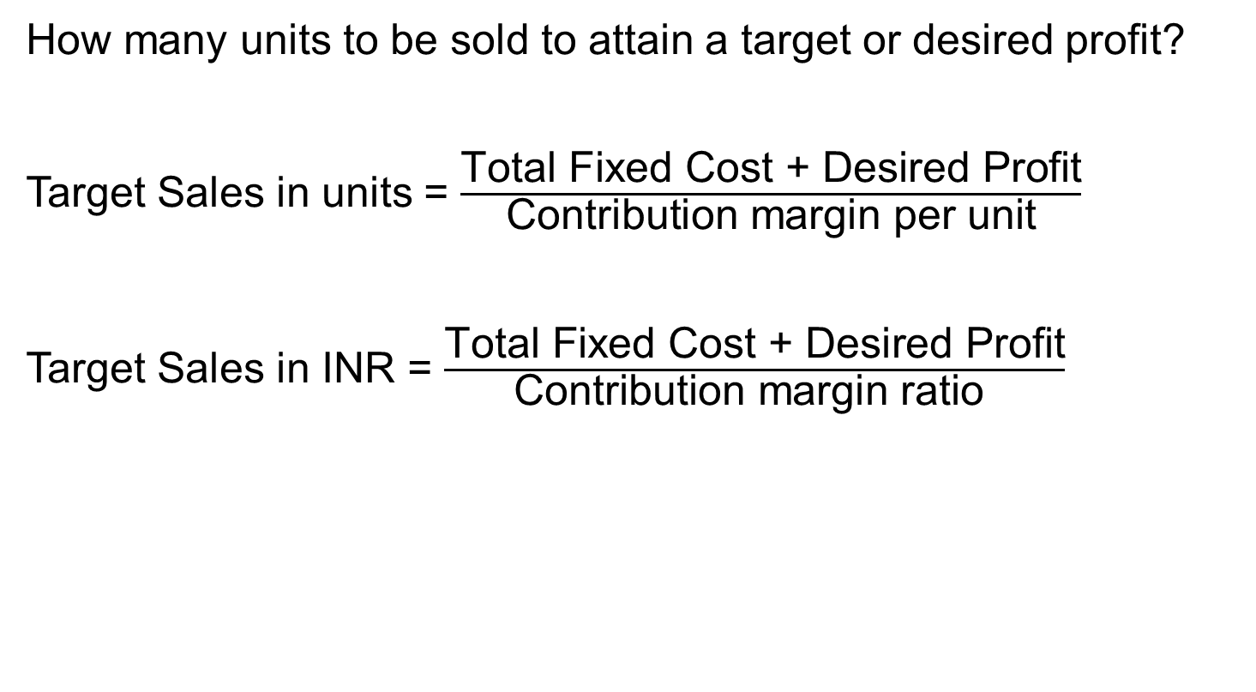
Target Profit
How many units to be sold to attain a target or desired profit?
Target Sales in units = $\frac{\text{Total} \text{Fixed} \text{Cost}\text{ + }\text{Desired} \text{Profit}}{\text{Contribution} \text{margin} \text{per} \text{unit}}$
Target Sales in INR = $\frac{\text{Total} \text{Fixed} \text{Cost}\text{ + }\text{Desired} \text{Profit}}{\text{Contribution} \text{margin} \text{ratio} }$

Slide 21
Margin of Safety
It is the difference between the budgeted sales revenue and the BEP sales revenue.
Margin of safety = Budgeted sales revenue - BEP sales revenue
It gives a sense that how close (safe) budgeted sales is to the BEP.

Slide 22
Assumptions of CVP analysis
All costs can be categorised as fixed or variable costs.
Selling price per unit, variable cost per unit, and total fixed costs remain constant as activity changes (volume varies).
The behaviour of selling price and total costs is linear.
In multi-product organisations, sales-mix remains constant.
There is only one cost driver: Number of units (Volume).
Production = Sales. It means that opening inventory and closing inventory are the same (Generally zero).

Slide 23
Practice Questions
The following information relates to a company, which produces a single product:
Direct labour per unit $ 12
Direct materials per unit $ 12
Variable overheads per unit $ 6
Total Fixed costs $ 600,000
Selling price per unit $ 60
Please compute break even point in units and amount (Solution: 20000 units and $ 1,200,000)
Please compute the level of output to earn target profit of $ 300,000 (Solution 30000 units and $ 1,800,000)

Slide 24
Practice Questions
A company makes a product with a selling price of $20 per unit and variable costs of $12 per unit. The fixed costs for the period are $40,000. What is BEP in units and $ amount? What is the required output level to make a target profit of $10,000?
Solution: Contribution = 20-12 = 8 per unit
BEP in units = Fixed costs/Contribution per unit = 40000/8 = 5000 Units. BEP in $ = 5000 units*20= $ 100,000
Desired Output = (Fixed cost+Desired profit)/ Contribution per unit = 50000/8 = 6250 Units.

Slide 25
Practice Questions
X Ltd. makes a product that sells for $50 per unit. It has variable costs of $30 per unit and incurs fixed costs of $100,000 per period. Construct the break-even chart for this operation (Showing VC, FC, TC, TR, BEP, Profit/Loss zones using levels of 3000, 5000, and 10000 units).
Also determine the sales value that the firm will have to reach if it is to make $20,000 profit per period. (Solution: $ 300,000)

Slide 26
Practice Questions
X manufactures soft toys for the European market. The soft toys sell for an average price of $16. The costs incurred ($) by the firm are as follows:
Materials (per toy) 5
Wages (per toy) 4
Packaging (per toy) 3
Rent of premises 5,000
Machinery hire 3,000
Marketing and administration 1,000
Calculate the following:
Contribution per toy sold
Break-even in units of output
Break-even level of sales revenue
Construct a break-even chart showing the break-even level of output
Source: https://textbook.stpauls.br/Economics/Business_Textbook/Operations_management_student/page_62.htm

Slide 27
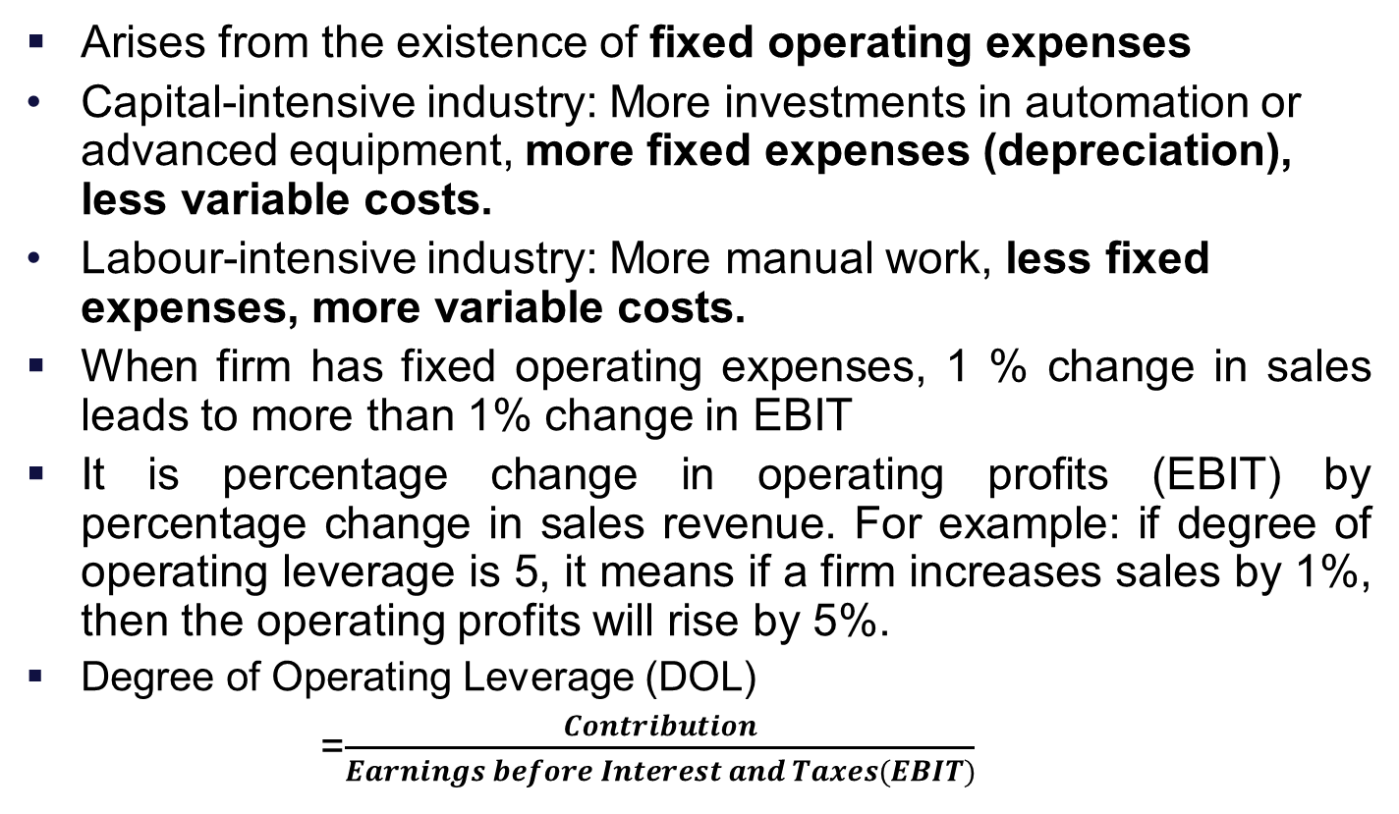
Leverage: Operating Leverage
Arises from the existence of fixed operating expenses
Capital-intensive industry: More investments in automation or advanced equipment, more fixed expenses (depreciation), less variable costs.
Labour-intensive industry: More manual work, less fixed expenses, more variable costs.
When firm has fixed operating expenses, 1 % change in sales leads to more than 1% change in EBIT
It is percentage change in operating profits (EBIT) by percentage change in sales revenue. For example: if degree of operating leverage is 5, it means if a firm increases sales by 1%, then the operating profits will rise by 5%.
Degree of Operating Leverage (DOL)
=$\frac{Contribution}{Earnings before Interest and Taxes(EBIT)}$

Slide 28
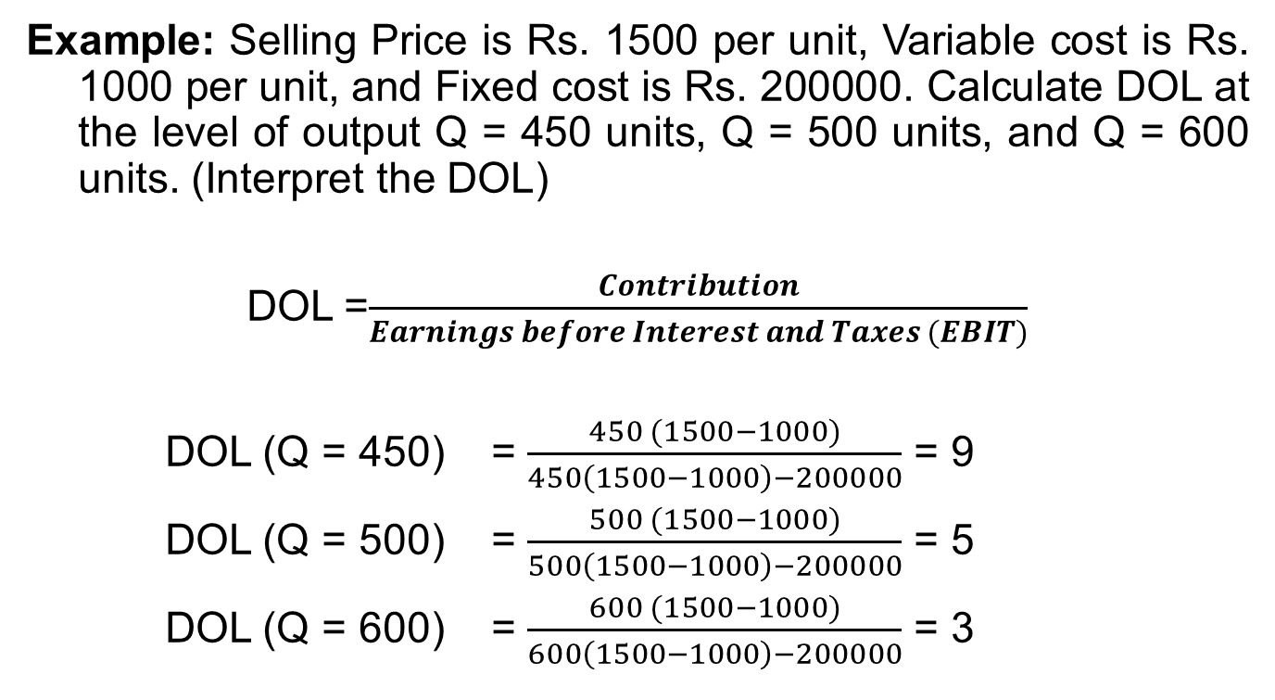
Operating Leverage
Example: Selling Price is Rs. 1500 per unit, Variable cost is Rs. 1000 per unit, and Fixed cost is Rs. 200000. Calculate DOL at the level of output Q = 450 units, Q = 500 units, and Q = 600 units. (Interpret the DOL)
DOL =$\frac{Contribution}{Earnings before Interest and Taxes (EBIT)}$
DOL (Q = 450) = $\frac{450 (1500−1000)}{450\left(1500−1000\right)−200000}$ = 9
DOL (Q = 500) = $\frac{500 (1500−1000)}{500\left(1500−1000\right)−200000}$ = 5
DOL (Q = 600) = $\frac{600 (1500−1000)}{600\left(1500−1000\right)−200000}$ = 3

Slide 29
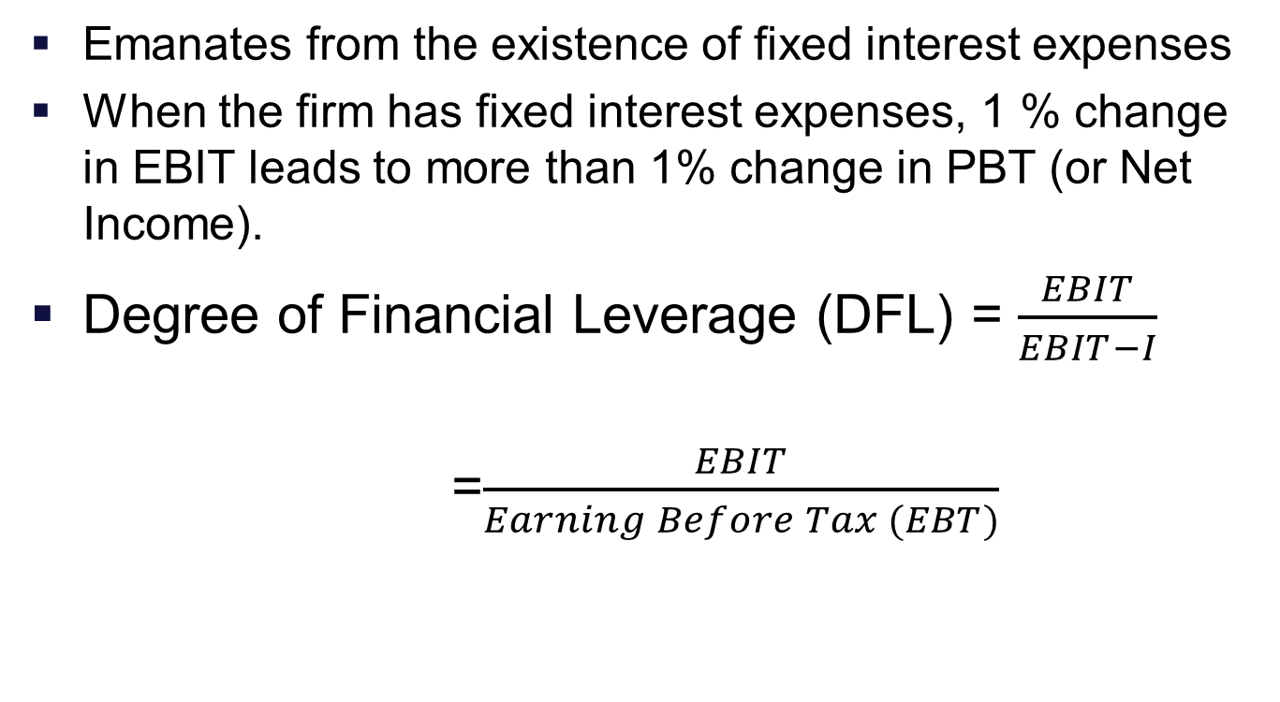
Financial Leverage
Emanates from the existence of fixed interest expenses
When the firm has fixed interest expenses, 1 % change in EBIT leads to more than 1% change in PBT (or Net Income).
Degree of Financial Leverage (DFL) = $\frac{EBIT}{EBIT−I}$
=$\frac{EBIT}{Earning Before Tax (EBT)}$

Slide 30
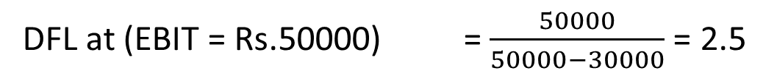
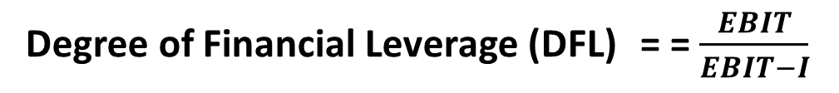
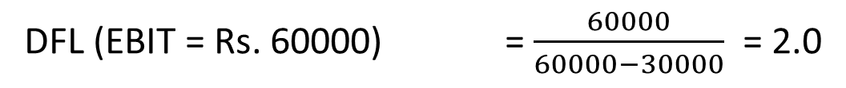
Financial Leverage
Example: Finex Ltd. is having currently an interest expense of Rs. 30000. Then the FL at EBIT = Rs. 50000 and EBIT = Rs. 60000 will be:
Degree of Financial Leverage (DFL) = = $\frac{EBIT}{EBIT−I}$
DFL at (EBIT = Rs.50000) = $\frac{50000}{50000−30000}$ = 2.5
DFL (EBIT = Rs. 60000) = $\frac{60000}{60000−30000}$ = 2.0

Slide 31
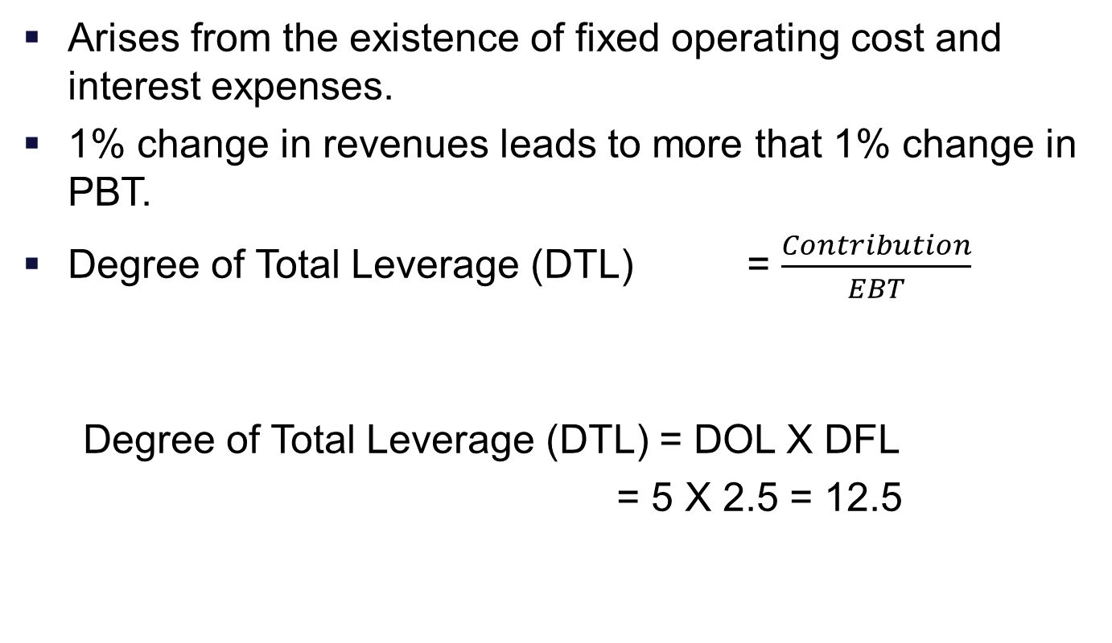
Total or Combined Leverage
Arises from the existence of fixed operating cost and interest expenses.
1% change in revenues leads to more that 1% change in PBT.
Degree of Total Leverage (DTL) = $\frac{Contribution}{EBT}$
Degree of Total Leverage (DTL) = DOL X DFL
= 5 X 2.5 = 12.5

Slide 32
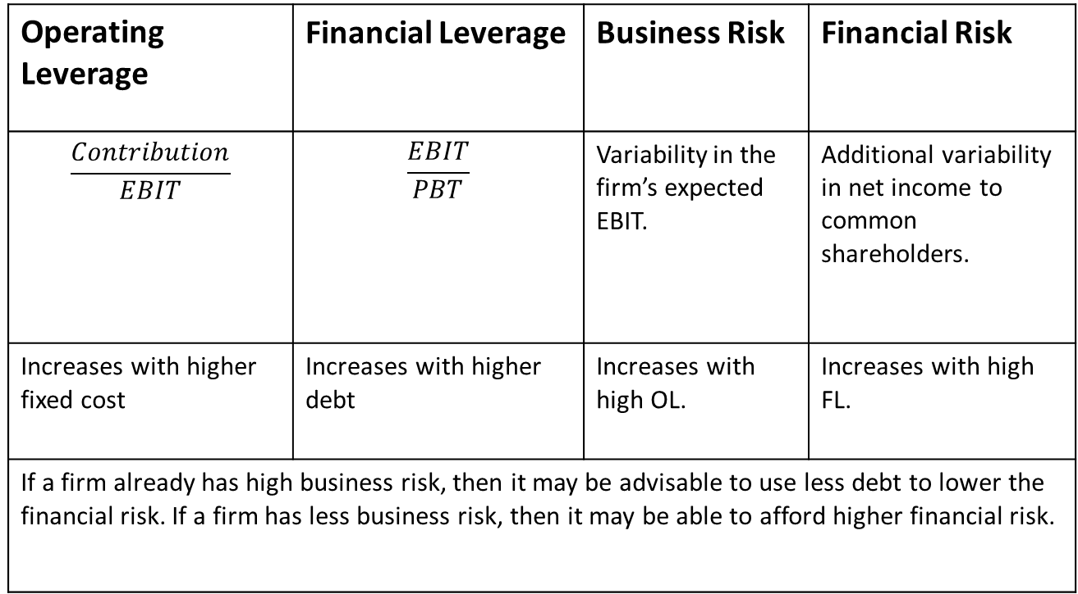
Summary
Operating Leverage | Financial Leverage | Business Risk | Financial Risk
$$\frac{Contribution}{EBIT}$$ | $$\frac{EBIT}{PBT}$$ | Variability in the firm’s expected EBIT. | Additional variability in net income to common shareholders.
Increases with higher fixed cost | Increases with higher debt | Increases with high OL. | Increases with high FL.
If a firm already has high business risk, then it may be advisable to use less debt to lower the financial risk. If a firm has less business risk, then it may be able to afford higher financial risk.

Slide 33
Combination of OL & FL and their combined effect
Operating Leverage | Financial Leverage | Combined Leverage
High | High | Very dangerous policy, must be avoided
Low | Low | Very cautious policy and not assuming risk
High | Low | Adverse effects of OL and are taken care by having low FL
Low | High | An ideal situation. The company can follow aggressive debt policy

Slide 34
Practice Problem 1 (Refer Excel)
VST corporation has sales of Rs.40 lakhs, variable cost 70 per cent of the sales and fixed cost is Rs.8 lakhs. The firm has raised Rs.20 lakhs funds by issue of debentures at the rate of 10 per cent. Compute DOL, DFL, and DCL.
Solution:
Sales | 4000000
Variable costs | 2800000
Contribution | 1200000
Fixed cost | 800000
EBIT | 400000 | DOL | 3
Interest | 200000 | DFL | 2
EBT | 200000 | DCL | 6

Slide 35
Practice Problem 2 (Refer Excel)
Ex.1: The following figures relate to two companies:
You are required to:
Calculate DOL, DFL and DTL for the two companies
Comment on the relative risk position of them
Particulars | X Ltd. (Rs in Lakh) | Y Ltd. (Rs. In Lakh)
Sales | 250 | 500
Variable Costs | 100 | 150
Contribution | 150 | 350
Fixed Costs | 75 | 200
EBIT | 75 | 150
Interest | 25 | 50
PBT | 50 | 100

Slide 36
Practice Problem 3 (Refer Excel)
Ex.2:
Find the operating leverage from the following data:
Sales Rs. 100000
variable Costs 60%
Fixed Costs Rs. 24000
Find the financial leverage from the following data:
Debt Rs. 1,50,00,000
Interest Rate 10%
Operating Profit (EBIT) Rs. 40,00,000

Slide 37
THANK YOU!!!

